Slide 1
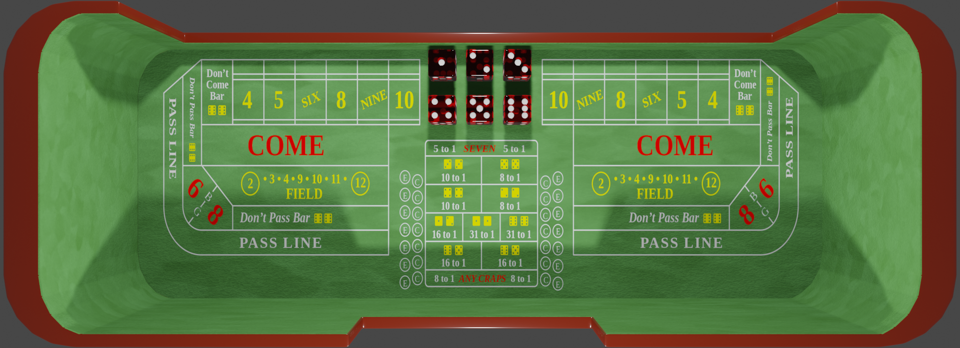
Rolling dice simulation Game start
This is the initial state of a game. The application is awaiting for a user input, which only option is to select a dice by clicking/taping the dice group.

Slide 2
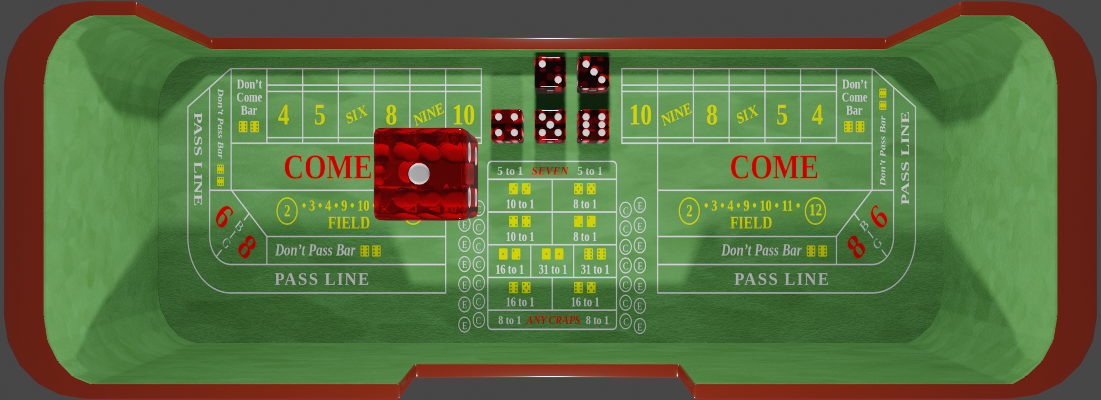
Rolling dice simulation Preroll
The player has chosen his first dice which is raised up and ready to roll. The player has now the option to mix it before rolling it : but it is not required, he could roll by left clicking the dice.

Slide 3
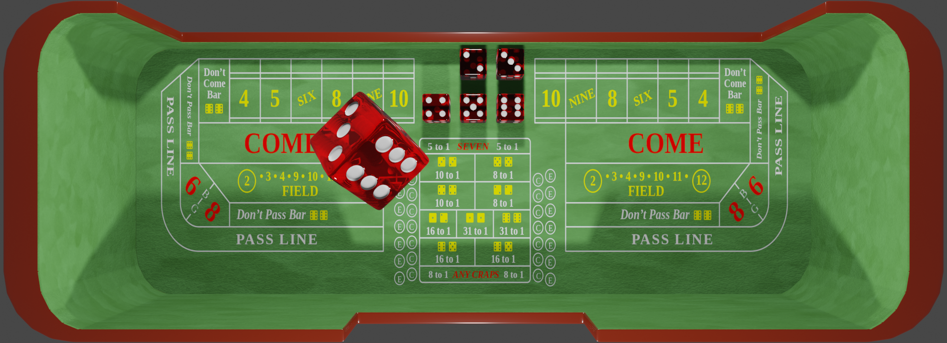
Rolling dice simulation Dice mixed
The player has mixed the dice. On a normal computer this could be done by pressing the mouse right button, dragging it into a random direction on the screen and then, releasing the mouse right button.

Slide 4
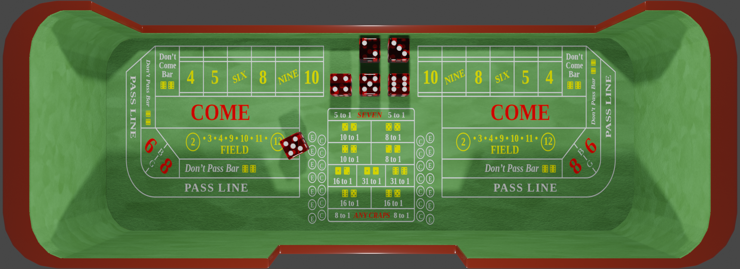
Rolling dice simulation Roll
The player has rolled his first dice. The dice then fell to the game board, bounced and rolled until it stopped showing its result on its top face. The player will now choose an other dice by left clicking on the dice group. The game then loop back from scene #2 until no dice are left in the initial dice group.

Slide 5
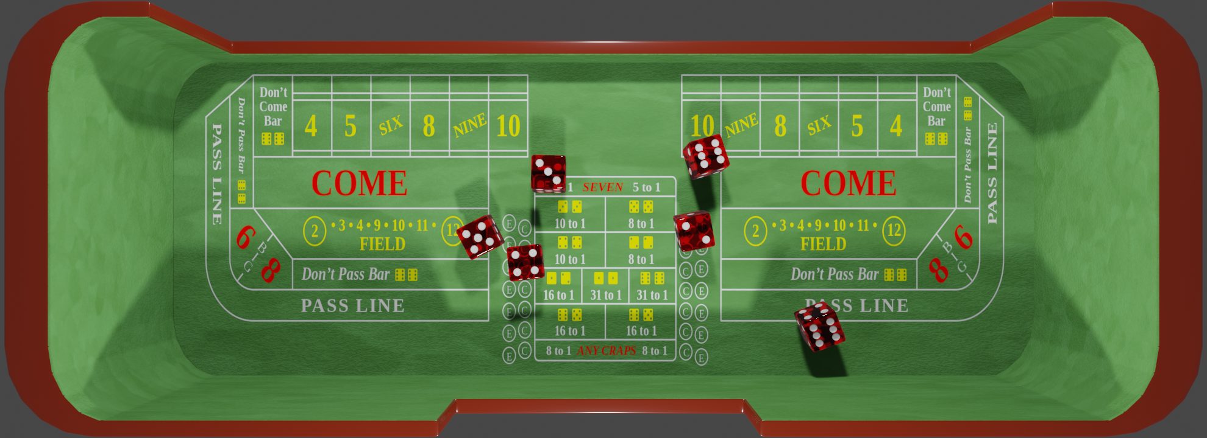
Rolling dice simulation Game over
The player has rolled all his dice. A left click on the game surface or a dice will start a new game, then the game go back to scene #1.

